Slide 1
Social Justice Behind and Beyond the Bars
Criminal Justice Health & Academic Medicine
Additional Resource

Slide 2
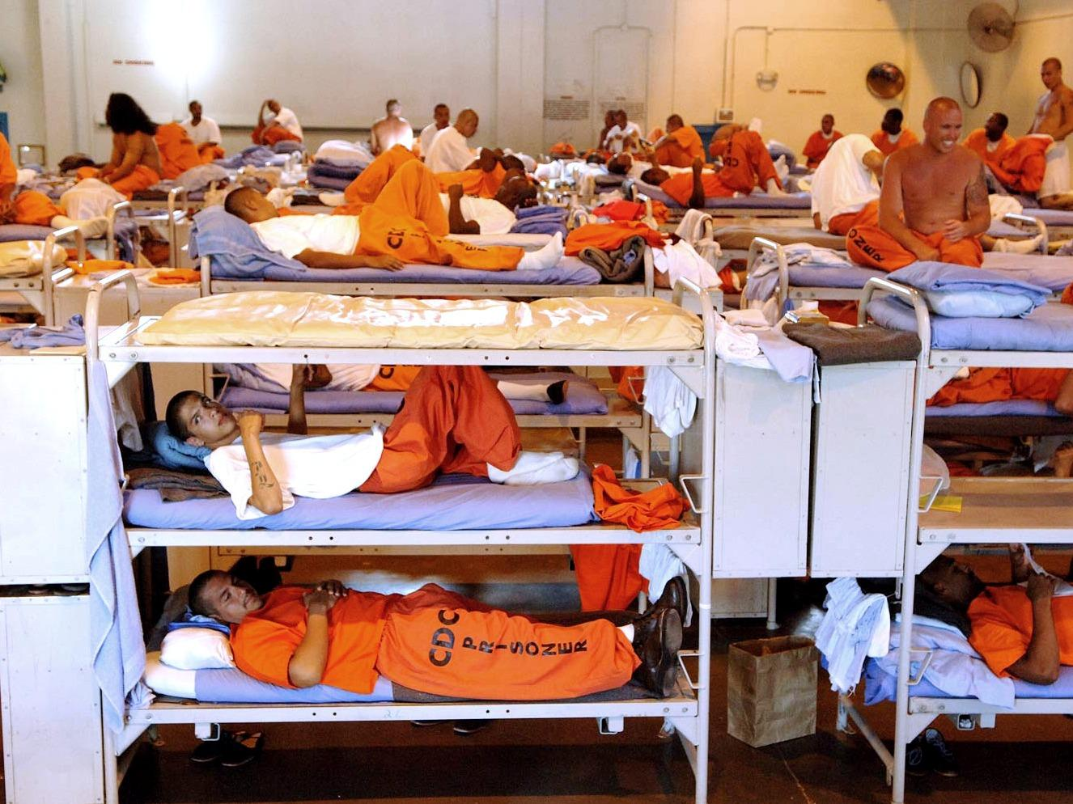
Epidemiology of Mass Incarceration
100 million Americans with criminal records
14 million
arrests annually
2.4 million incarcerated
(1 in 108)
1 in 35 adults
CJ supervised
80% of convictions involve substances
Veterans at
increased risk
15% with serious mental illness
Source: Ferguson et al. JHCPU
May 2016. In Press.; Photo: ©2006 www.cdcr.ca.gov
Notes:
Point One : Mass incarceration is an historic problem. Read captions. The United States incarcerates more people than any country in the world and we have seen a 500% increase in the incarcerated population in the U.S. over 30 years. Root causes include the War on Drugs for which President Clinton has recently provided half-hearted apology given unintended consequences and deinstitutionalization of indviduals with serious mental illness.

Slide 3
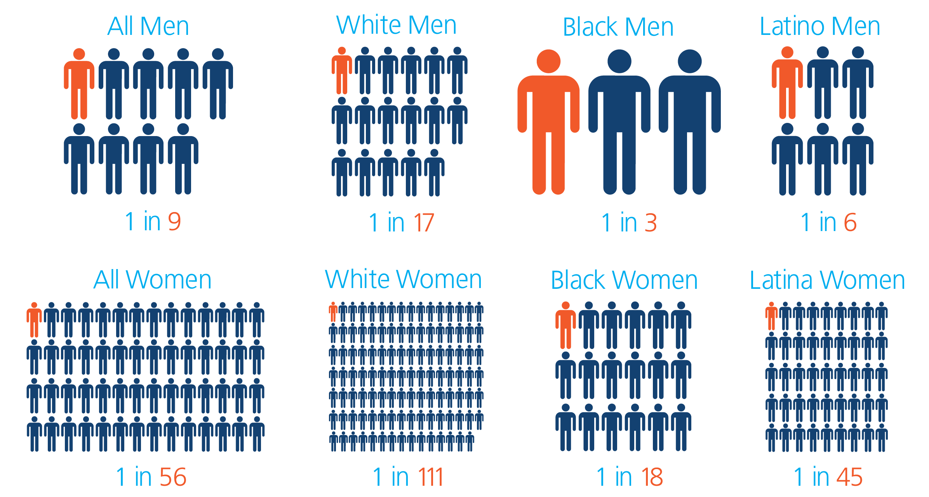
Lifetime Likelihood of Incarceration
70% of Black
men with less
than HS
education
jailed by 40
Black youth
are 7x more
likely to
be tried
as adult
Source: Bonczar, T. (2003). Prevalence of Imprisonment in the US
Population, 1974-2001. Washington, D.C.: Bureau of Justice Statistics
Notes:
Men are substantially more likely than women to experience incarceration. However, when we turn our attention to populations of color, there is a huge disparity, particularly for African Americalns, when it comes to incarceration. One in three black men have a lifetime risk of incarceration and one in six Latino men. This disparity extends to women. Furthermore, 70% of black men with less than a HS education are jailed by 40 and black youth are 7x more likely to be tried as an adult. White people seeing these statistics for the first time might be shocked but step into the shoes of our colleagues of color and consider the visceral and deeply personal threat that such statistics signify.

Slide 4

Sesame Street Goes to Jail
Photo: ©2013 Sesame Workshop
Notes:
Beyond the numbers, now consider the downstream impact on families, children and grandchildren. Then it will come as no surprise that Sesame Street sought to address the impact on children by creating the video, Little Children, Big Challenges: Incarceration where a new character named Alex interviewed children who had a parent who was incarcerated.

Slide 5
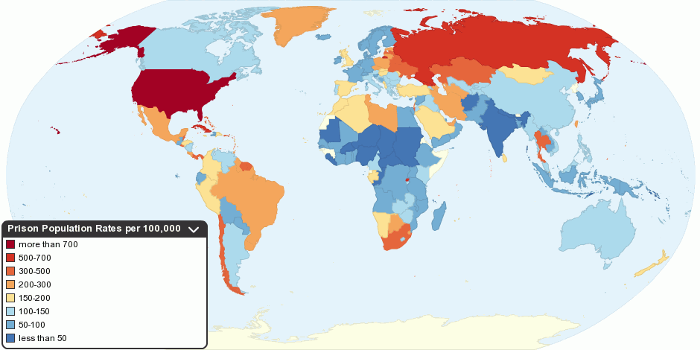
How did the land of the free become incarceration nation?
Notes:
The land of the free, the land of liberty, of individual freedom------------- imprisons more of its citizenry than any other sovereignty in the history of modern civilization.
Thi- We have 5 % of the global population, but 25 percent of the world’s prisoners

Slide 6
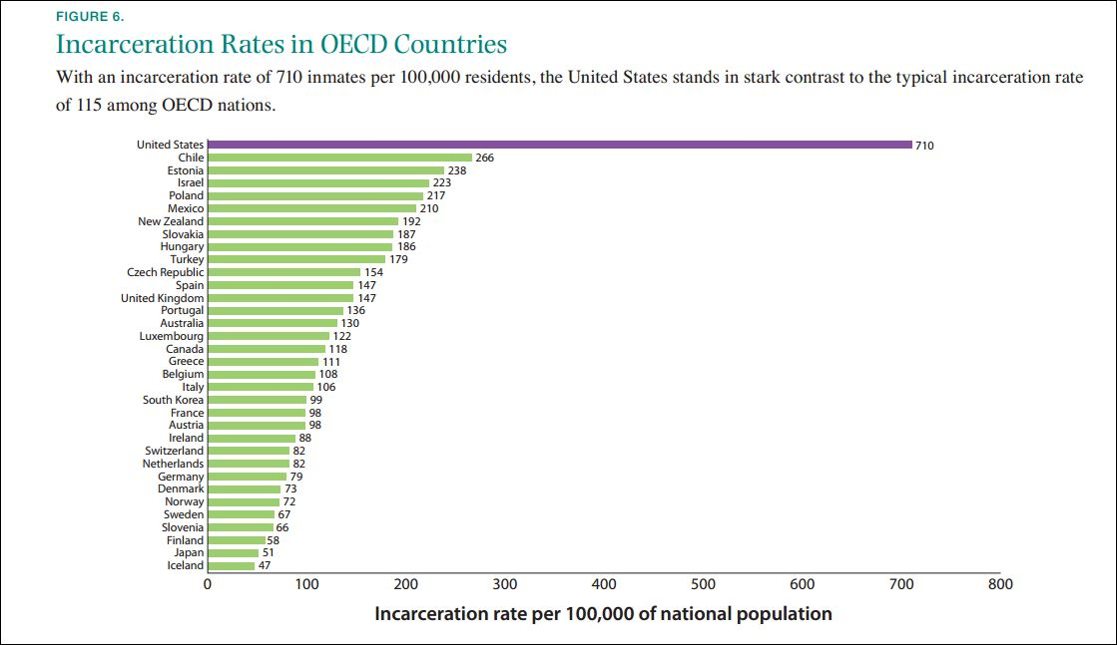
Notes:
The land of the free, the land of liberty, of individual freedom------------- imprisons more of its citizenry than any other sovereignty in the history of modern civilization.
Thi- We have 5 % of the global population, but 25 percent of the world’s prisoners

Slide 7
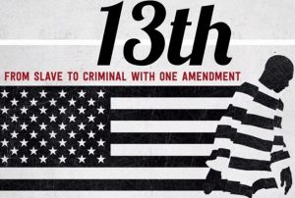
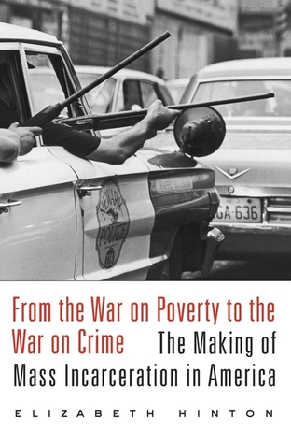
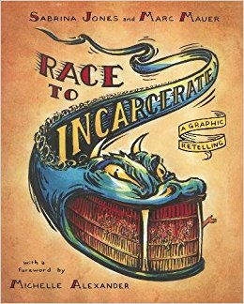

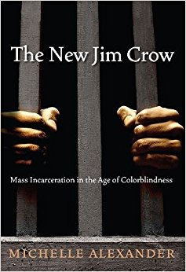
Your holiday reading and film list…
1865-1930s:
Criminal justice system has origins in racial control and labor exploitation
Convict leasing post-Civil War and Emancipation
1945-1970s
Backlash in major cities to Civil Rights Movement
War on Poverty --War on Crime
1970s-1990s:
War on Drugs
Mandatory Minimums
Truth in Sentencing
Prison Boom
Notes:
Mass incarceration is tied to systemic structures of slavery, labor exploitation, convict leasing, white rebellion against the Civil Rights Movement, an

Slide 8
Driving Forces since 1970s:
Crime alone does not explain
War on Drugs
Abandonment of rehabilitation
Mandatory minimums and truth in sentencing
Punitive politics
Increased prosecutorial power
Failure of deinstitutionalization and deep cuts to Medicaid and social welfare
1996 Crime Bill
Crime and Imprisonment Rates 1960-2010
Notes:
A range of interrelated factors underlie the rise of mass incarceration:
-

Slide 9
Why is mass incarceration a public health problem?

Slide 10
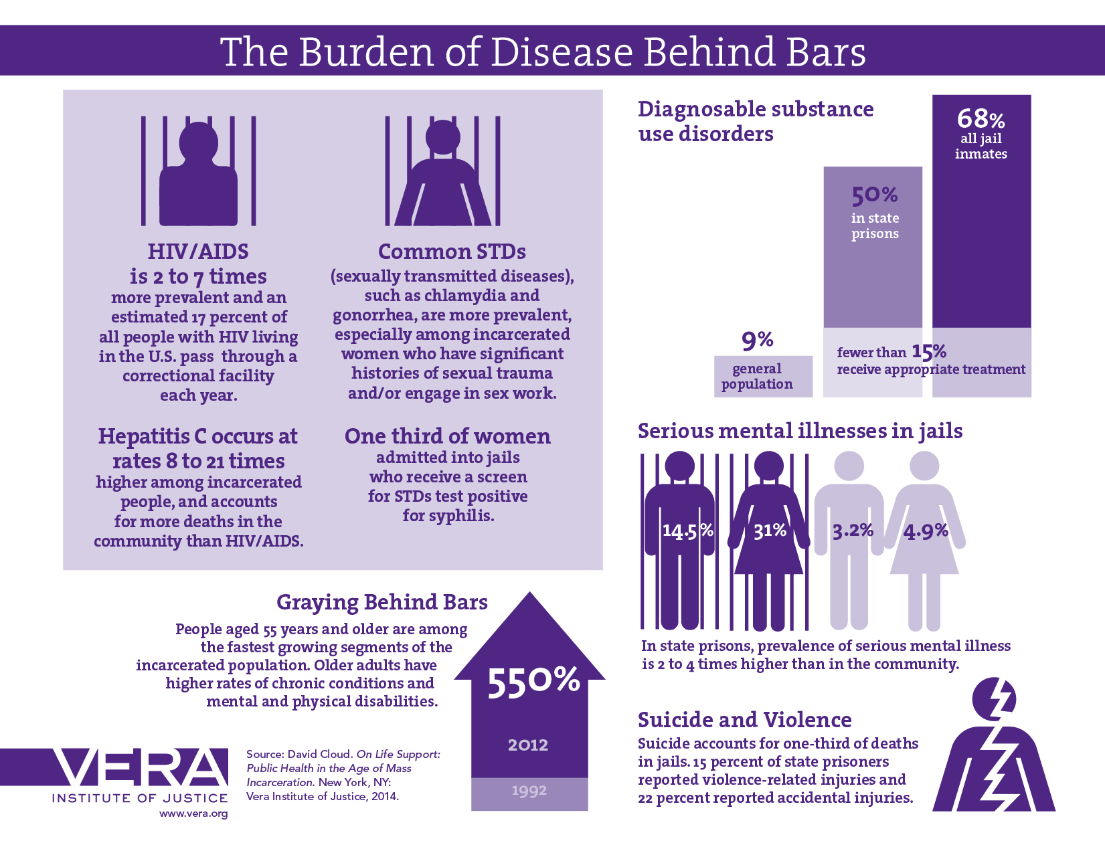

Slide 11
Jails and prisons are largest behavioral health provider in most states, especially for people who are poor, uninsured, and underserved.

Slide 12
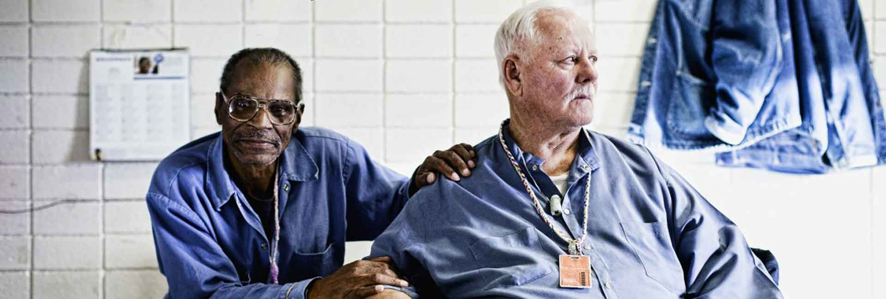
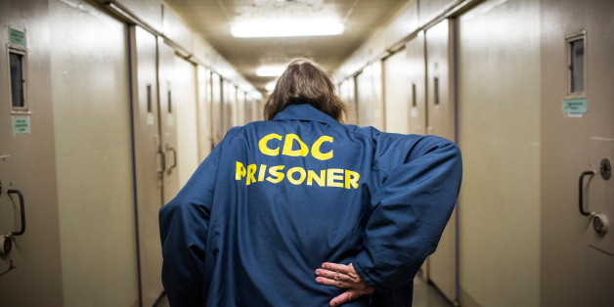
Aging behind bars is a mounting crisis

Slide 13
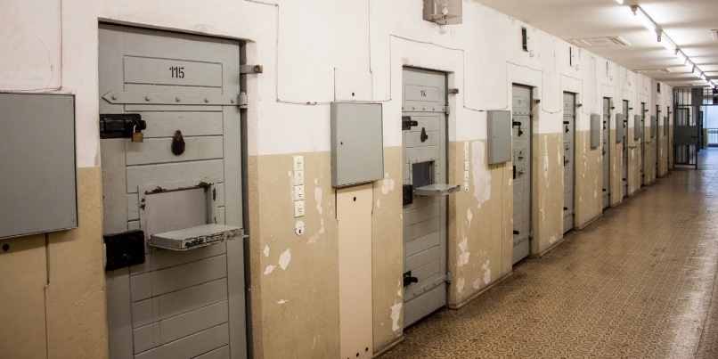
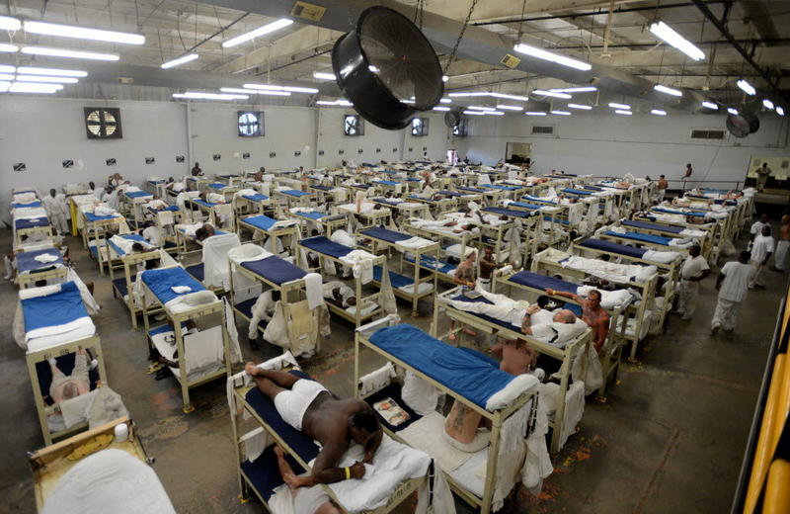
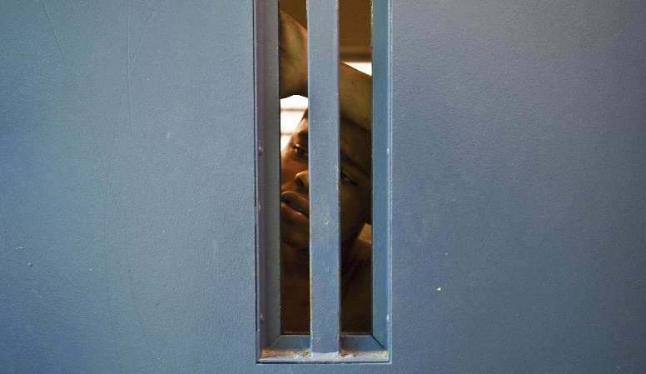
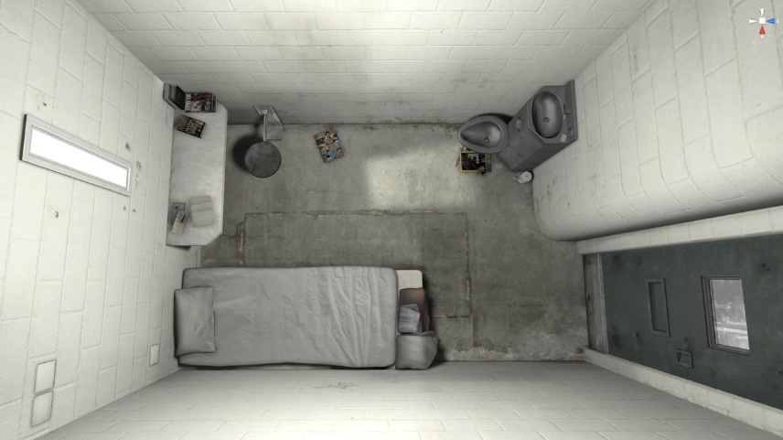
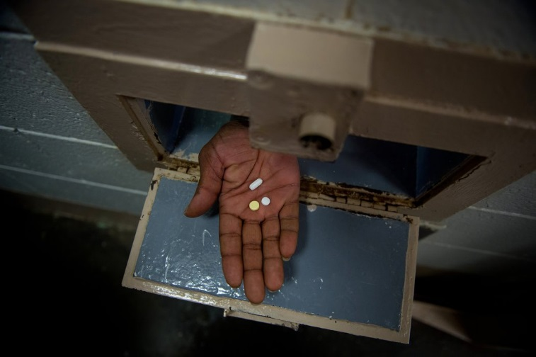
Living conditions in correctional environments
Violence
Solitary Confinement
Inadequate medical care
Idleness
Overcrowding
Notes:
Direct effects:
correctional facilities are unhealthy environments, where individuals are exposed to a range of conditions that are detrimental to physical and mental health—overcrowding, violence, poor nutrition, unsanitary conditions, and solitary confinement.
As the US Supreme Court affirmed in the landmark case Plata v. Brown (2011) addressing overcrowding in Californian prisons, such conditions can result in an “unconscionable degree of suffering and death.”
HIV example:
1) Exposure to conditions inside prisons that transmit disease (poor testing, sexual violence, condoms are contraband)
2) Systematic removal of black men from urban areas– has played a major role in driving inequalities in HIV infections and AIDS related deaths by altering demographic composition of neighborhoods, altering sexual networks, and exacerbating poverty and addiction.

Slide 15
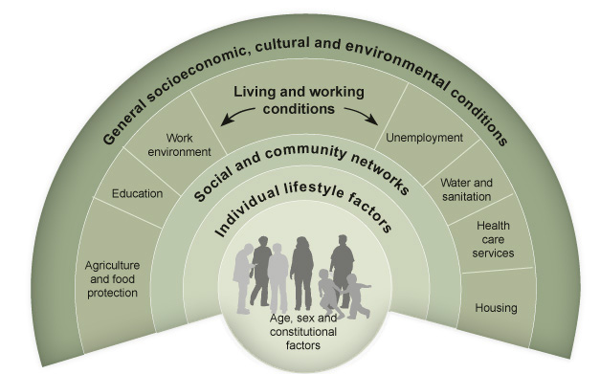
Familial and community level exposure to the criminal justice system has far-reaching effects beyond the individual by impacting known social determinants of health:

Slide 16
Medical institutions can play a role in reform…
Advocacy, policy, and ethics
  Physician’s voices on valuable in local advocacy
  Compassionate release for elderly
  Expansion of mental health, substance use, and housing
  Medical institution should prioritize justice-system reform and correctional health as component of policies to address health inequities
  Human rights and medical ethics in correctional settings
Direct services:
  Create jail diversion programs
  Continuity of care at reentry
  Jail diversion programs
  MAT
Expanding the mission of correctional health:
  Break down silos between correctional and mainstream healthcare
  Train human rights oriented medical students to work in correctional settings
Research:
  Examine the physiological consequences of criminal justice exposures over the lifecourse
Notes:
U.S. needs more physicians speaking out on mass incarceration issues

